Slide 1
Field-Effect Transistors
Become familiar with the construction and operating characteristics of Junction Field Effect (JFET), Metal-Oxide Semiconductor FET (MOSFET),
Be able to sketch the transfer characteristics from the drain characteristics of a JFET, MOSFET,
The BJT transistor is a current-controlled device as depicted in Fig. 6.1a , whereas the JFET transistor is a voltage-controlled device as shown in Fig. 6.1b .

Slide 2
Types of FET’s
JFET – Junction Field Effect Transistor
MOSFET – Metal Oxide Semiconductor Field Effect Transistor
D-MOSFET - Depletion Mode MOSFET
E- MOSFET - Enhancement Mode MOSFET

Slide 3
Construction of the n -channel JFET
There are two types of JFET’s: n-channel and p-channel. The n-channel is more widely used.
There are three terminals: Drain (D) and Source (S) are connected to n-channel Gate (G) is connected to the p-type material

Slide 4
JFET Operating Characteristics
VGS = 0 V, VDS Some Positive Value
The instant the voltage VDD (=VDS) is applied, the electrons are drawn to the drain terminal, establishing the conventional current I_{D} with the defined direction of Fig. 6.5 .
The path of charge flow clearly reveals that the drain and source currents are equivalent (I_{D} = I_{S}). Under the condition
In Fig. 6.5 , the flow of charge is relatively uninhibited and is limited solely by the resistance of the n -channel between drain and source.

Slide 5
JFET Operating Characteristics
VGS = 0 V, VDS Some Positive Value
The more horizontal the curve, the higher the resistance, suggesting that the resistance is approaching “infinite” ohms in the horizontal region.
If V DS is increased to a level where it appears that the two depletion regions would“touch” as shown in Fig. 6.8 , a condition referred to as pinch-off will result. The level of V DS that establishes this condition is referred to as the pinch-off voltage and is denoted by VP , as shown in Fig. 6.7 .

Slide 6
JFET Operating Characteristics
V GS < 0 V
The voltage from gate to source, denoted V_{GS} , is the controlling voltage of the JFET.
Just as various curves for I_{C} versus V_{CE} were established for different levels of I_{B} for the BJT transistor, curves of I_{D} versus V_{DS} for various levels of V_{GS} can be developed for the JFET

Slide 7
JFET Operating Characteristics:
p -Channel Devices
For the p -channel device, the channel will be constricted by increasing positive voltages from gate to source and the double-subscript notation for V DS will result in negative voltages for V DS on the characteristics of Fig. 6.13 , which has an I DSS of 6 mA and a pinch off voltage of VGS = +6 V.

Slide 8
JFET Operating Characteristics
There are three basic operating conditions for a JFET:
JFET’s operate in the depletion mode only
VGS = 0, VDS is a minimum value depending on IDSS and the drain and source resistance
VGS < 0, VDS at some positive value and
Device is operating as a Voltage-Controlled Resistor
For an n channel JFET, VGS may never be positive*
For an p channel JFET, VGS may never be negative*

Slide 9
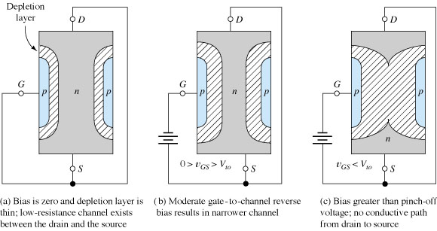
N-Channel JFET Operation
The nonconductive depletion region becomes thicker with increased reverse bias.
(Note: The two gate regions of each FET are connected to each other.)

Slide 10
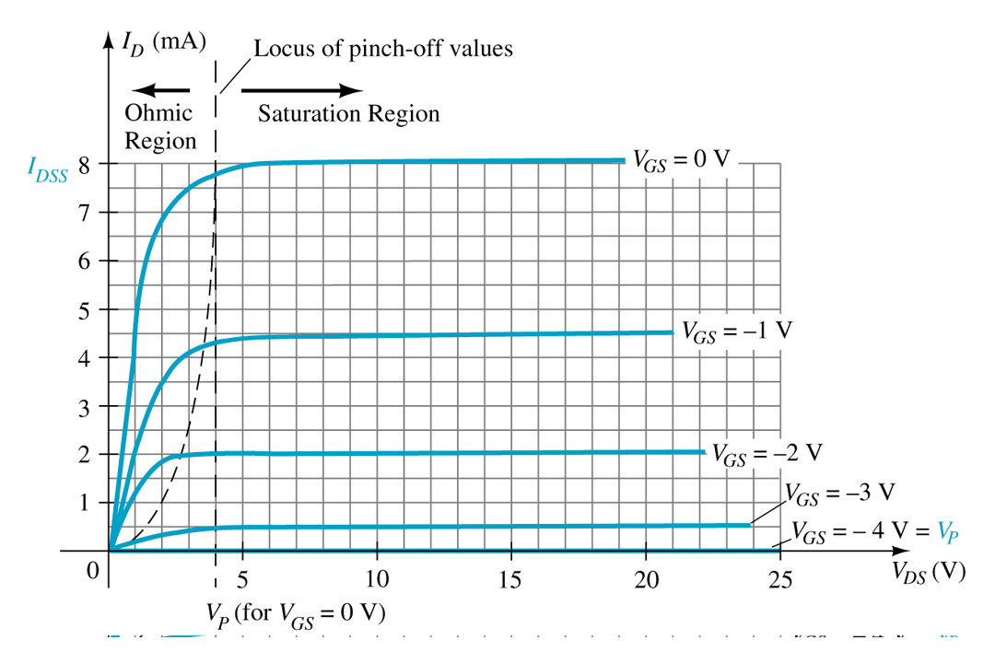
ID ≤ IDSS
As V_{GS} becomes more negative:
• the JFET will pinch-off at a lower voltage (Vp).
• I_{D} decreases (I_{D} < I_{DSS}) even though V_{DS} is increased.
• Eventually I_{D} will reach 0A. V_{GS} at this point is called Vp or V_{GS(off)}.
• Also note that at high levels of V_{DS} the JFET reaches a breakdown situation. ID will increases uncontrollably if V_{DS} > V_{DSmax}.

Slide 11
Symbols
VGS = 0 V, ID = IDSS ;
cutoff (ID = 0 A) VGS less than the pinch-off level;
ID is between 0 A and IDSS for VGS 0 V and greater than the pinch-off level.

Slide 12
TRANSFER CHARACTERISTICS

Slide 13
TRANSFER CHARACTERISTICS
Applying Shockley’s Equation

Slide 14
TRANSFER CHARACTERISTICS

Slide 15
TRANSFER CHARACTERISTICS
Shorthand Method

Slide 18
IMPORTANT RELATIONSHIPS

Slide 19
MOSFET’s

Slide 20
MOSFETs
MOSFETs have characteristics similar to JFETs and additional characteristics that make then very useful
There are 2 types of MOSFET’s:
Depletion mode MOSFET (D-MOSFET)
Operates in Depletion mode the same way as a JFET when VGS ≤ 0
Operates in Enhancement mode like E-MOSFET when VGS > 0
Enhancement Mode MOSFET (E-MOSFET)
Operates in Enhancement mode
IDSS = 0 until VGS > VT (threshold voltage)

Slide 21
Basic construction of the n -channel depletion-type MOSFET
It is the insulating layer of SiO₂ in the MOSFET construction that accounts for the very desirable high input impedance of the device.
Because of the very high input impedance, the gate current I_{G} is essentially ~0 A for dc biased configurations.

Slide 22
Basic Operation and Characteristics
the gate-to-source voltage is set to 0 V by the direct connection from one terminal to the other, and a voltage V_{DD} is applied across the drain-to-source terminals.
The result is a current similar to that flowing in the channel of the JFET. In fact, the resulting current with V _{GS} = 0 V continues to be labeled I_{DSS} ,

Slide 23
Basic Operation and Characteristics
Depletion region
The more negative the bias, the higher is the rate of recombination. The resulting level of drain current is therefore reduced with increasing negative bias for V_{GS} ,
Enhancement region
For positive values of V GS , the positive gate will draw additional electrons (free carriers) from the p -type substrate

Slide 24
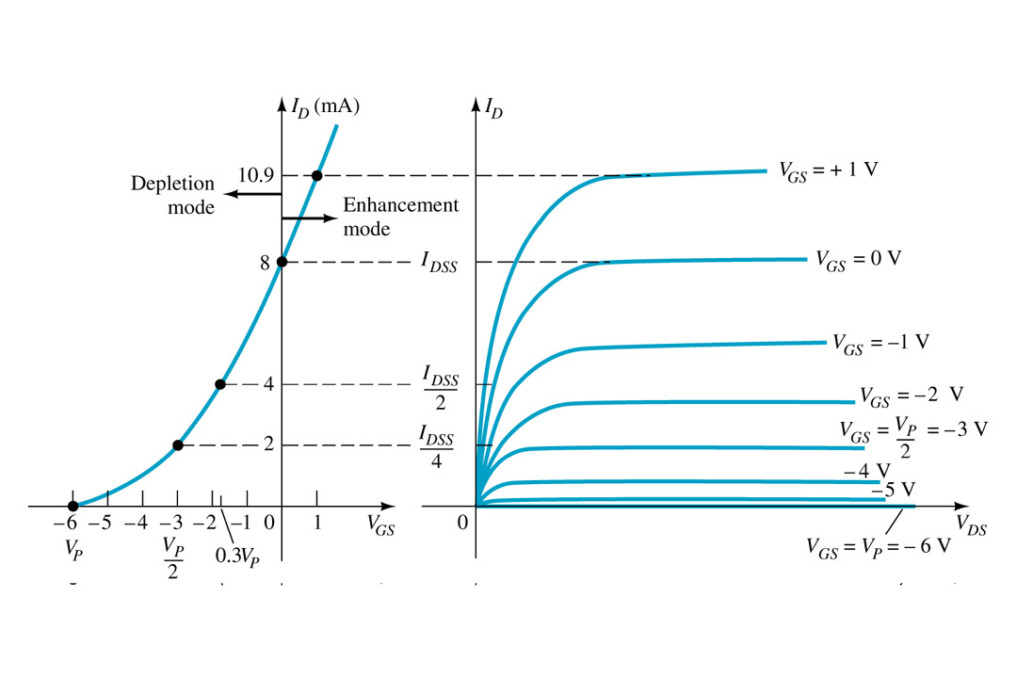
Basic Operation
A D-MOSFET may be biased to operate in two modes:
the Depletion mode or the Enhancement mode

Slide 25
D-MOSFET Depletion Mode Operation
The transfer characteristics are similar to the JFET
In Depletion Mode operation:
When VGS = 0V, ID = IDSS
When VGS < 0V, ID < IDSS
When VGS > 0V, ID > IDSS
The formula used to plot the Transfer Curve, is:

Slide 27
p -Channel Depletion-Type MOSFET
The drain characteristics would appear exactly as in Fig. 6.26 , but with V_{DS} having negative values, I_{D} having positive values as indicated (since the defined direction is now reversed), and V_{GS} having the opposite polarities as shown in Fig. 6.29c . The reversal in V_{GS} will result in a mirror image (about the I_{D} axis) for the transfer characteristics as shown in Fig. 6.29b .

Slide 28
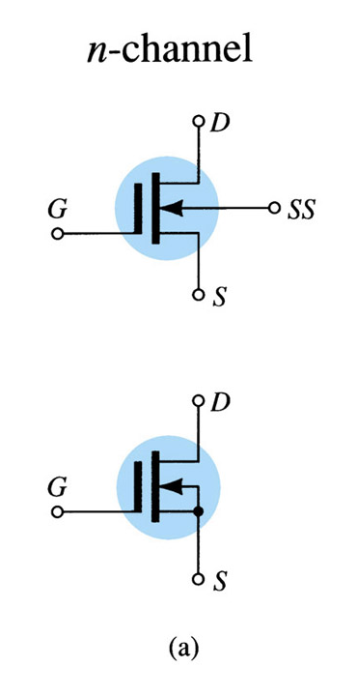
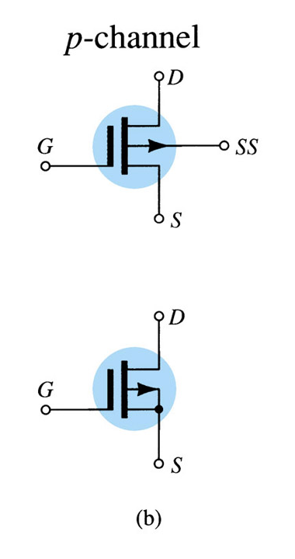
D-MOSFET Symbols

Slide 29
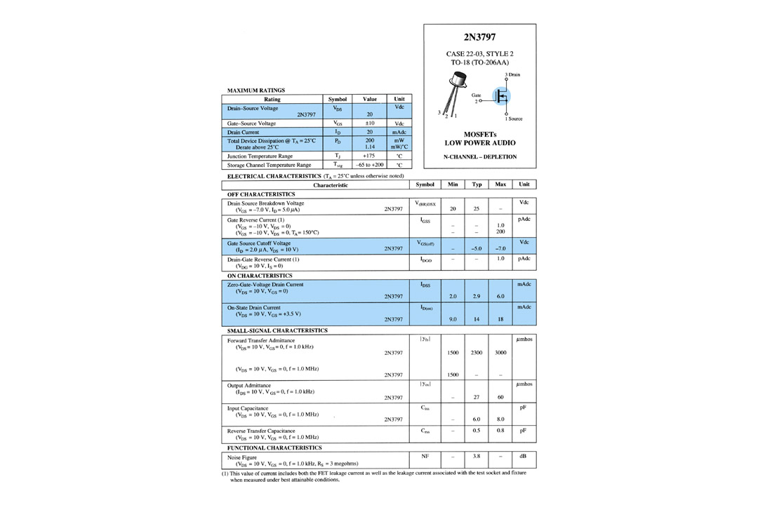
Specification Sheet

Slide 30
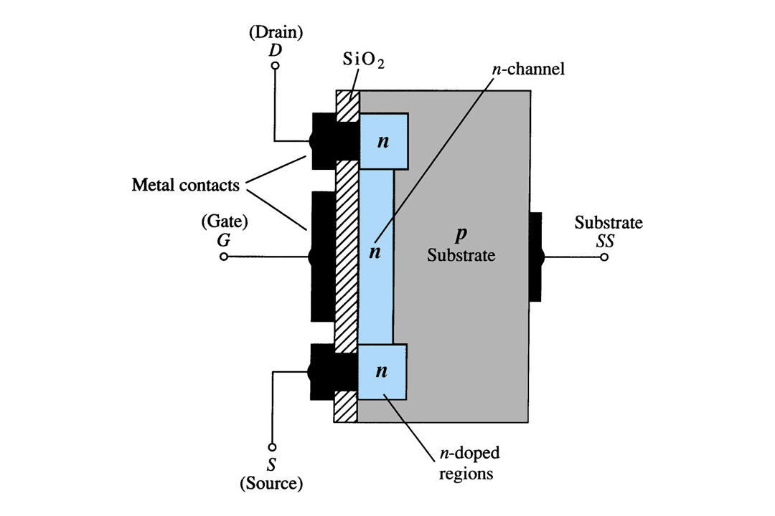
Depletion Mode MOSFET Construction
The Drain (D) and Source (S) leads connect to the to n-doped regions These N-doped regions are connected via an n-channel This n-channel is connected to the Gate (G) via a thin insulating layer of SiO₂ The n-doped material lies on a p-doped substrate that may have an additional terminal connection called SS

Slide 31
D-MOSFET Enhancement Mode Operation
Enhancement Mode operation
In this mode, the transistor operates with V_{GS} > 0V, and I_{D} increases above I_{DSS}
Shockley’s equation, the formula used to plot the Transfer Curve, still applies but VGS is positive:

Slide 32
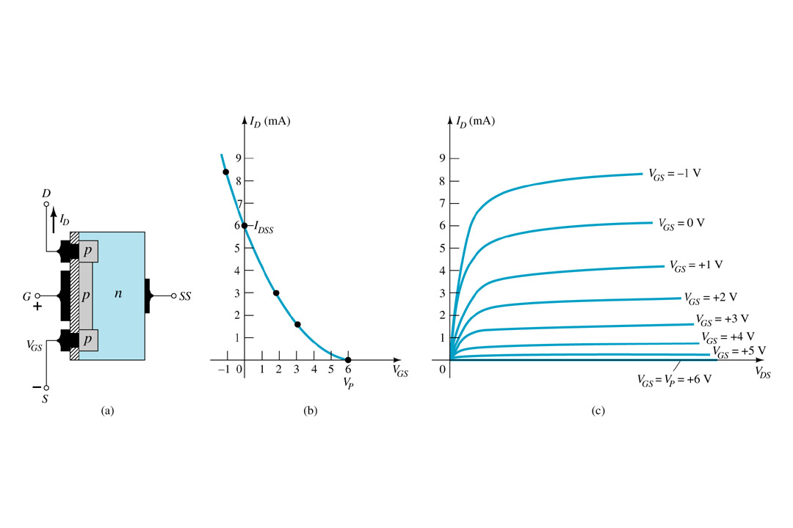
p-Channel Depletion Mode MOSFET
The p-channel Depletion mode MOSFET is similar to the n-channel except that the voltage polarities and current directions are reversed

Slide 33
Enhancement Mode MOSFET’s

Slide 34
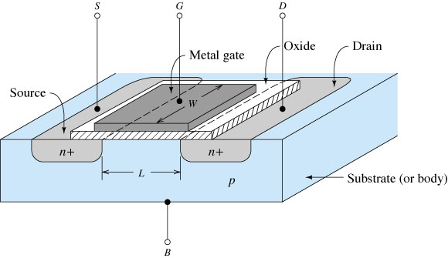
n-Channel E-MOSFET showing channel length L and channel width W

Slide 35
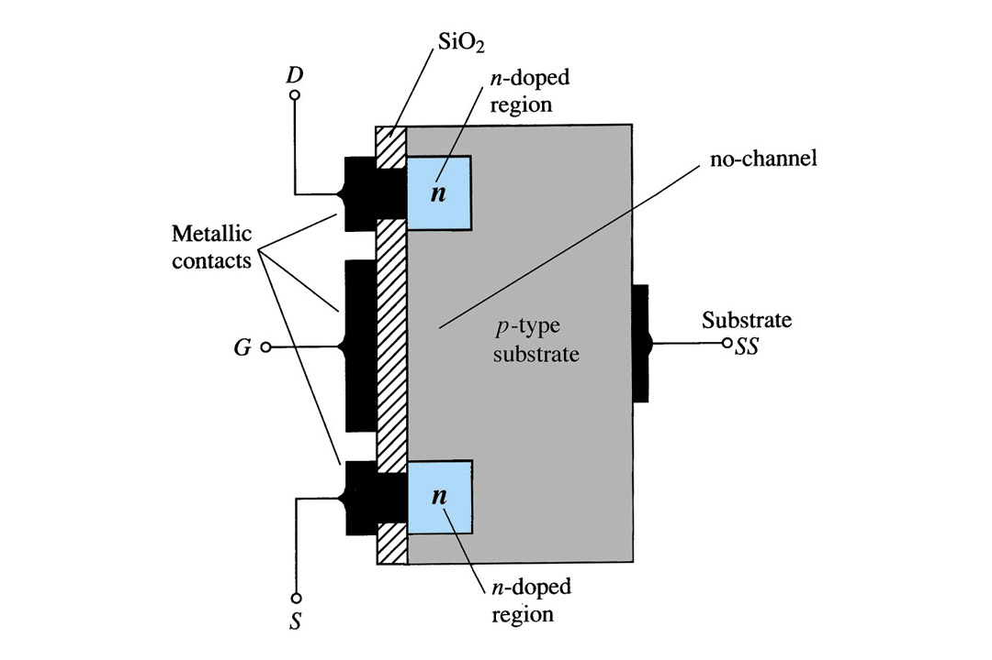
Enhancement Mode MOSFET Construction
The Drain (D) and Source (S) connect to the to n-doped regions
These n-doped regions are not connected via an n-channel without an external voltage
The Gate (G) connects to the p-doped substrate via a thin insulating layer of SiO₂
The n-doped material lies on a p-doped substrate that may have an additional terminal connection called SS

Slide 36
Basic Operation and Characteristics
If VGS is set at 0 V and a voltage applied between the drain and the source of the device
the absence of an n -channel (with its generous number of free carriers) will result in a current of effectively 0 A—quite different from the depletion-type MOSFET and JFET, where I_{D} = I_{DSS}.
there are in fact two reverse-biased p – n junctions between the n -doped regions and the p -substrate to oppose any significant flow between drain and source

Slide 37
Basic Operation and Characteristics
Both V_{DS} and V_{GS} have been set at some positive voltage greater than 0 V, establishing the drain and the gate at a positive potential with respect to the source
As V_{GS} increases in magnitude, the concentration of electrons near the SiO₂ surface increases until eventually the induced n -type region can support a measurable flow between drain and source.
The level of V_{GS} that results in the significant increase in drain current is called the threshold voltage and is given the symbol V_{T} .
I_{D}
V_{GS}
By the application of a positive gate-to-source voltage, this type of MOSFET is called an enhancement-type MOSFET

Slide 38
Basic Operation and Characteristics
As V_{GS} is increased beyond the threshold level, the density of free carriers in the induced channel will increase, resulting in an increased level of drain current.
However, if we hold V_{GS} constant and increase the level of V_{DS} , the drain current will eventually reach a saturation level as occurred for the JFET and depletion-type MOSFET.
The leveling off of I_{D} is due to a pinching-off process depicted by the narrower channel at the drain end of the induced channel as shown in Fig. 6.34 .
If V _{GS} is held fixed at some value such as 8 V and V _{DS} is increased from 2 V to 5 V, the voltage V _{DG} [by Eq. (6.13)] will increase from -6 V to -3 V and the gate will become less and less positive with respect to the drain.
I_{D}
Eventually, the channel will be reduced to the point of pinch-off and a saturation condition will be established
any further increase in V_{DS} at the fixed value of V_{GS} will not affect the saturation level of I_{D} until breakdown conditions are encountered.
V_{DS}

Slide 39
Basic Operation and Characteristics
The level of V _{T} is 2 V, as revealed by the fact that the drain current has dropped to 0 mA. In general, therefore:
For values of V GS less than the threshold level, the drain current of an enhancement type MOSFET is 0 mA.
V_{DS}

Slide 40
Characteristics for an n-channel enhancement-type MOSFET from the drain characteristics
For levels of VGS 7 VT, the drain current is related to the applied gate-to-source voltage by the following nonlinear relationship:

Slide 41
Characteristics for an n-channel enhancement-type MOSFET from the drain characteristics
The k term is a constant that is a function of the construction of the device.
The value of k can be determined from the following equation
where I_{D}(on) and V_{GS}(on) are the values for each at a particular point on the characteristics of the device.

Slide 42
Characteristics for an n-channel enhancement-type MOSFET from the drain characteristics
it must be remembered that the drain current is 0 mA for VGS … VT. As V GS is increased beyond V T , the drain current I D will begin to flow at an increasing rate in accordance with Eq. (6.15).

Slide 43
p -Channel Enhancement-Type MOSFETs
The terminals remain as identified, but all the voltage polarities and the current directions are reversed.

Slide 44
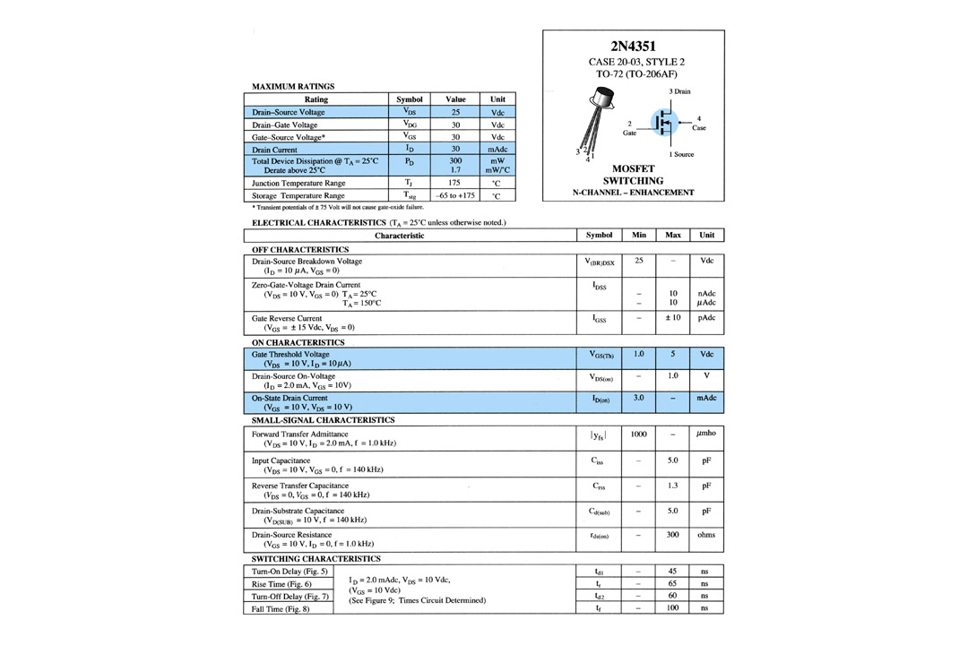
Specification Sheet

Slide 45
EXAMPLE 6.4 Using the data provided on the specification sheet of Fig. 6.40 and an average threshold voltage of VGS(Th) = 3 V, determine:
a. The resulting value of k for the MOSFET.
b. The transfer characteristics

Slide 46
p -Channel Enhancement-Type MOSFETs
The terminals remain as identified, but all the voltage polarities and the current directions are reversed.

Slide 47
Symbols, Specification Sheets, and Case Construction

Slide 48
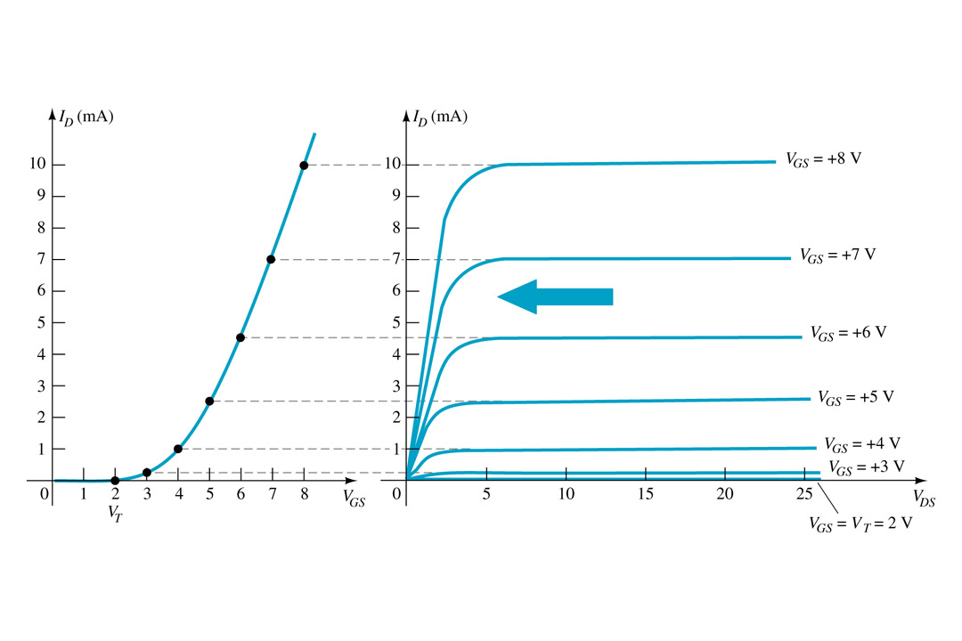
Wrap up: Basic Operation
The Enhancement mode MOSFET only operates in the enhancement mode.
VGS is always positive
IDSS = 0 when VGS < VT
As VGS increases above VT, ID increases
If VGS is kept constant and VDS is increased, then ID saturates (IDSS)
The saturation level, VDSsat is reached.

Slide 49
Wrap up: Transfer Curve
To determine ID given VGS:
where VT = threshold voltage or voltage at which the MOSFET turns on.
k = constant found in the specification sheet
The PSpice determination of k is based on the geometry of the device:

Slide 50
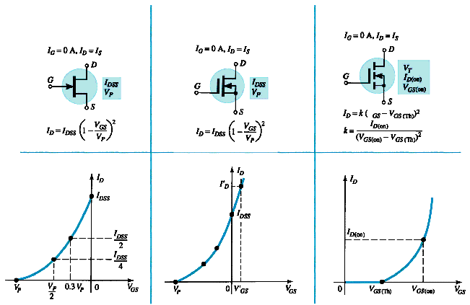
Summary Table
JFET
D-MOSFET
E-MOSFET

Slide 51
Summary Table

